Slide 1
CIS 4560
Team Presentation
Group 1: Alan Liu, Samuel Park, Steven Vallejo, Keith Wang

Slide 2
Goal
To help provide a transparent view on government-related spending
Provide a thorough and organized visualization on government spending

Slide 3

The official source for spending data for the U.S. Government.
Data is uploaded directly from more than a hundred federal agencies' financial systems.
See how your tax money is being spent!

Slide 4
Data Source Information
Data Size: ~12GB
Data Source URL: https://www.usaspending.gov/#/download_center/award_data_archive

Slide 5
What do we want to find?
We're going to evaluate this data to find minimum, maximum, averages, and other similar metrics about U.S. spending in the 2017-18 fiscal year, as well as visualizing it through a graph to find trends. We can also gain insights about the spending behavior as it relates to the type of spending and the contractors used.

Slide 6
Hadoop & Hive Versions
Hadoop | Hadoop 2.7.1.2.4.2.0-258
Hive | Hive 1.2.1000.2.4.2.0-258

Slide 7
Hadoop & Hive Versions

Slide 8
Hardware Experimental Specifications
Bash command:
lscpu
Shows CPU information
Oracle Big Data Compute Edition | 5 Nodes
OCPUs | 10
Memory | 150 GB
Storage | 678 GB
HDFS Capacity | 147 GB
CPU Speed | 2.2 GHz
Notes:
OCPU Oracle Compute Units [1]: An OCPU is defined as the CPU capacity equivalent of one physical core of an Intel Xeon processor with hyper threading enabled. For Intel Xeon processor each OCPU corresponds to two hardware execution threads, known as vCPUs.

Slide 9
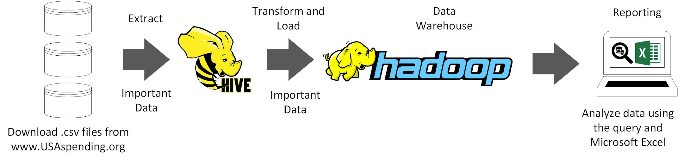
ETL Architecture
Notes:
load and process data through Hive to pull out important useful information
Format then load formatted data into hadoop
Then data can be analyzed through excel

Slide 10
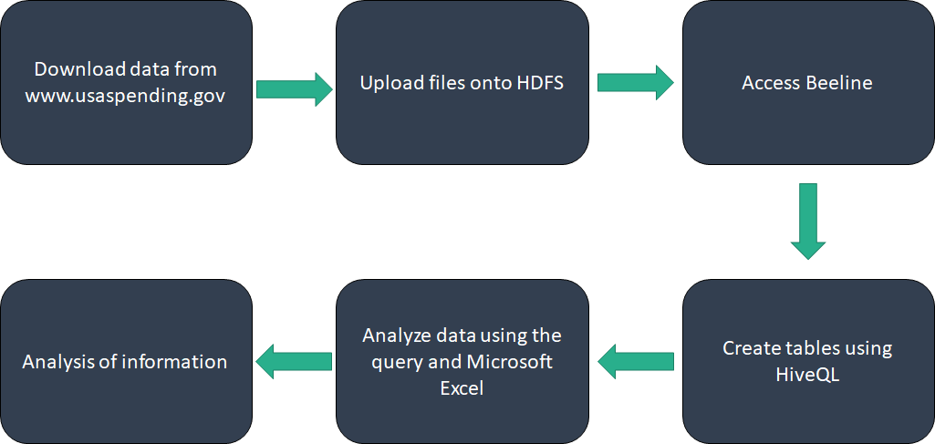
Flow Chart of Data Analysis

Slide 11
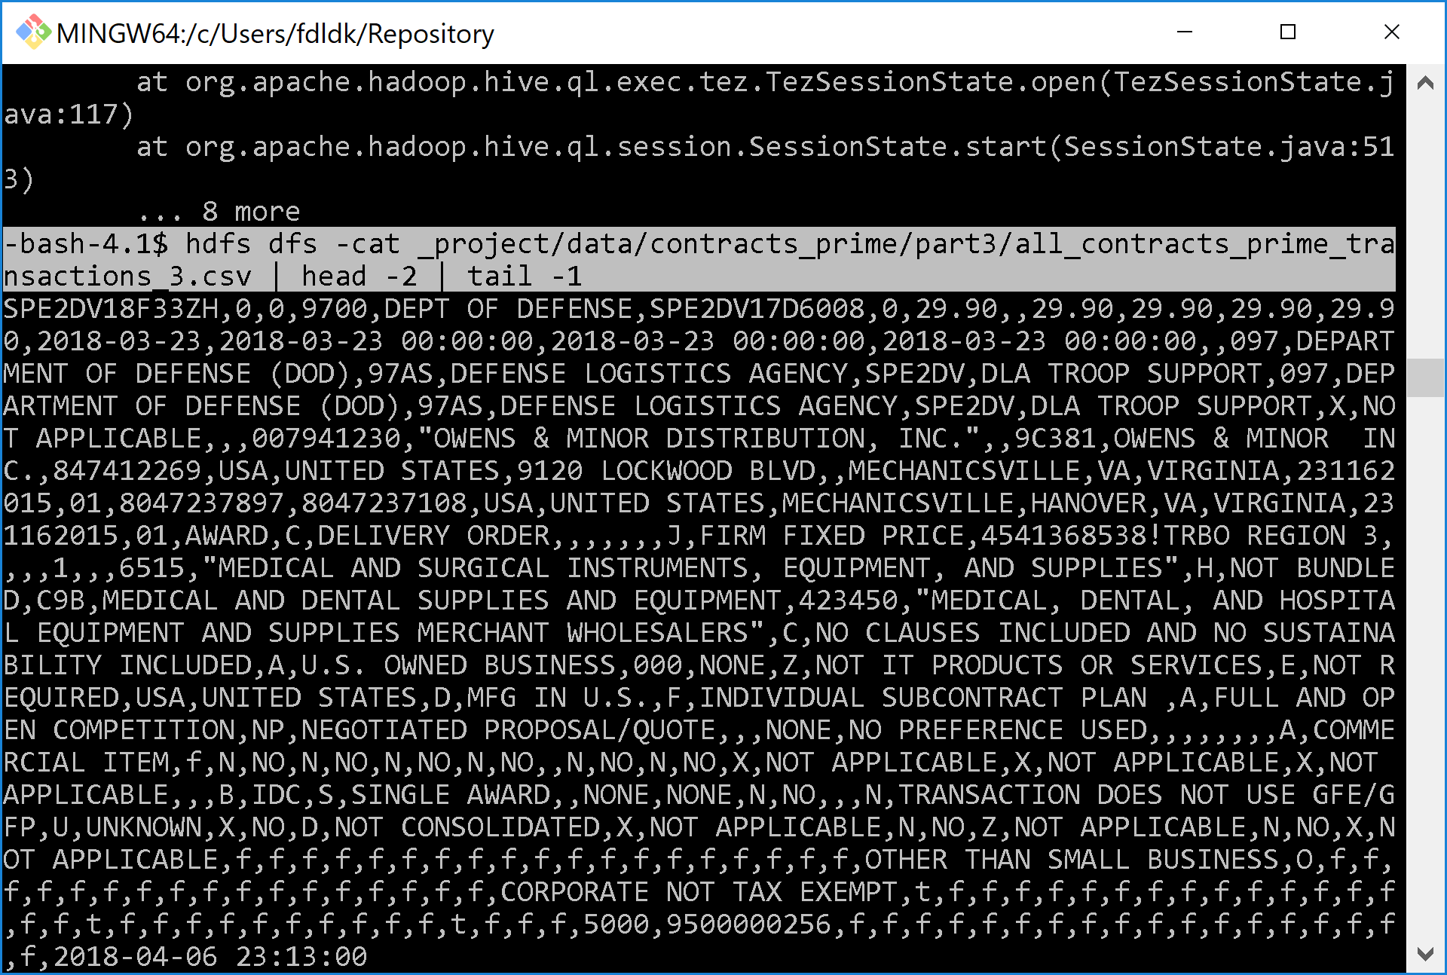
Sample Data Row

Slide 12
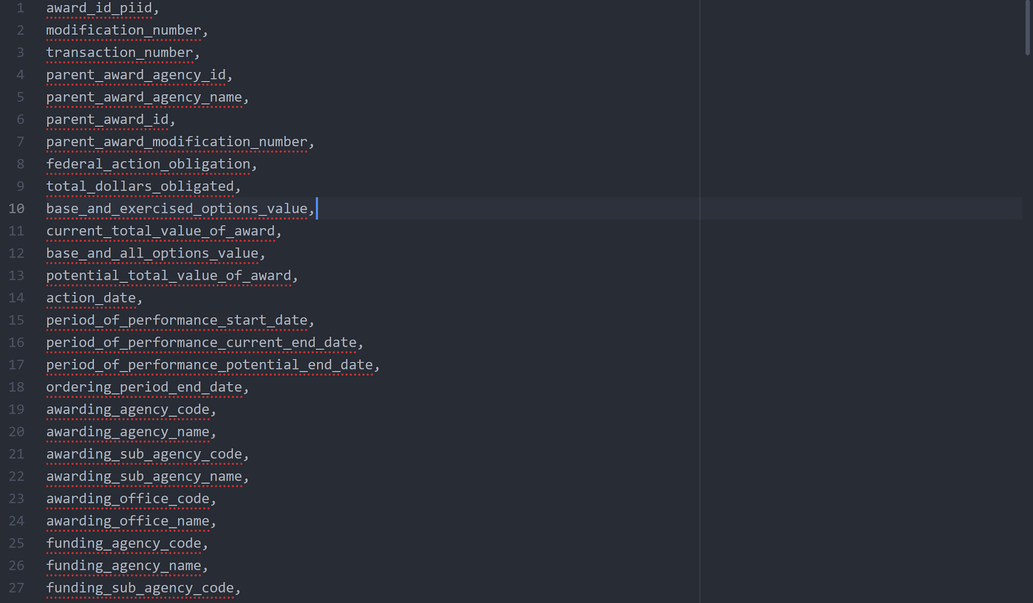
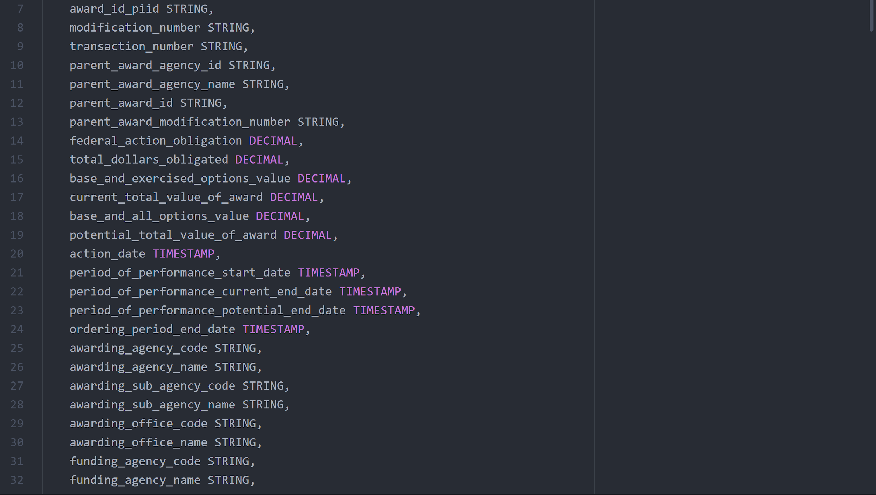
Data Headers

Slide 13
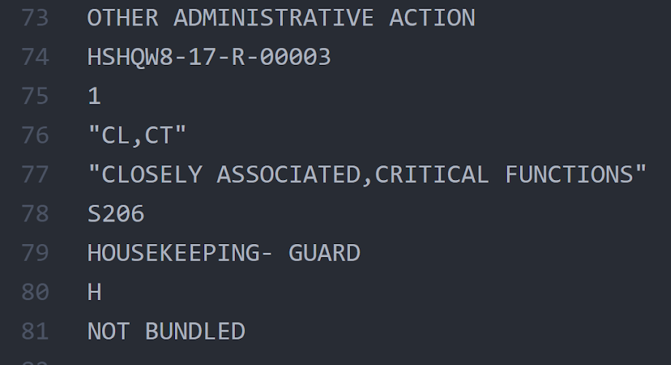
Correctly Reading Rows

Slide 14
Contract Table Parts
CREATE EXTERNAL TABLE IF NOT EXISTS contracts_prime_NNN
(
award_id_piid STRING,
modification_number STRING,
transaction_number STRING,
parent_award_agency_id STRING,
...256 more lines...
last_modified TIMESTAMP
)
ROW FORMAT SERDE 'org.apache.hadoop.hive.serde2.OpenCSVSerde'
WITH SERDEPROPERTIES (
"separatorChar" = ",",
"quoteChar" = "\""
)
STORED AS TEXTFILE
LOCATION '/user/svallej5/_project/data/contracts_prime/partNNN/'
TBLPROPERTIES ('skip.header.line.count'='1');

Slide 15
Contract Table Trimmed
INSERT INTO TABLE contracts_prime_trimmed
SELECT
award_id_piid,
transaction_number,
parent_award_agency_id,
parent_award_agency_name,
parent_award_id,
parent_award_modification_number,
federal_action_obligation,
total_dollars_obligated,
...59 more lines...
annual_revenue,
last_modified
FROM contracts_prime_1;

Slide 16
Assistance Table Parts
CREATE EXTERNAL TABLE IF NOT EXISTS assist_prime_NNN (
award_id_fain STRING,
modification_number STRING,
award_id_uri STRING,
sai_number STRING,
federal_action_obligation STRING,
non_federal_funding_amount DECIMAL,
...65 more lines...
last_modified_date TIMESTAMP
)
ROW FORMAT SERDE 'org.apache.hadoop.hive.serde2.OpenCSVSerde'
WITH SERDEPROPERTIES (
"separatorChar" = ",",
"quoteChar" = "\""
)
STORED AS TEXTFILE
LOCATION '/user/svallej5/_project/data/assist_prime/partNNN/'
TBLPROPERTIES ('skip.header.line.count'='1');

Slide 17
Assistance Table Trimmed
INSERT INTO TABLE assist_prime_trimmed
SELECT
award_id_fain,
non_federal_funding_amount,
total_funding_amount,
...25 more lines...
award_description,
action_type_description,
last_modified_date
FROM assist_prime_NNN;

Slide 18
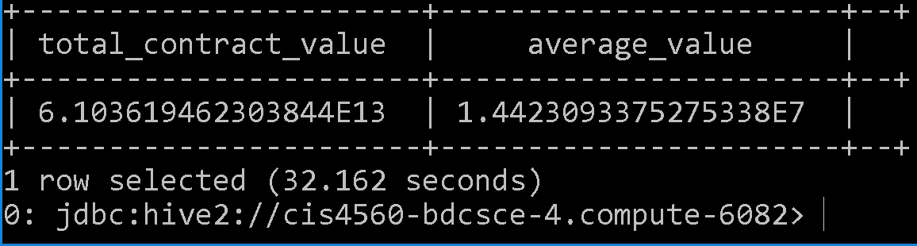
Total Spending on Contracts
SELECT sum(current_total_value_of_award) Total_Contract_Value, avg(current_total_value_of_award) Average_Value FROM contracts_prime_trimmed;

Slide 19
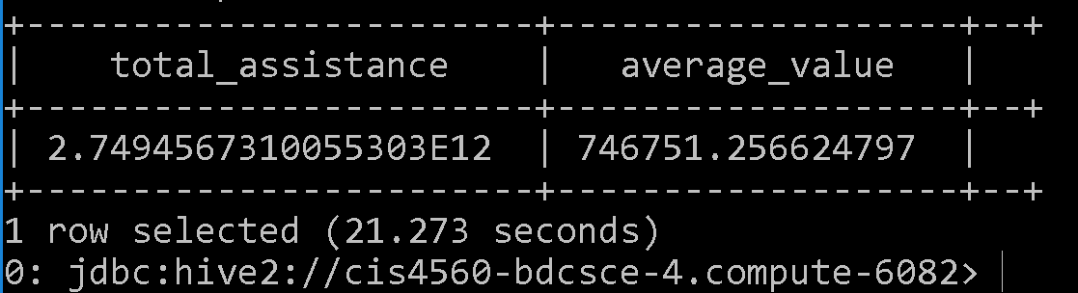
Total Assistance Spending
SELECT sum(total_funding_amount) Total_Assistance, avg(total_funding_amount) Average_Value FROM assist_prime_trimmed;

Slide 20
Top Contract Recipients in California
SELECT
recipient_name,
sum(current_total_value_of_award) Total_Value
FROM contracts_prime_trimmed
WHERE recipient_state_name = 'CALIFORNIA'
GROUP BY recipient_name
ORDER BY Total_Value DESC LIMIT 10;

Slide 21
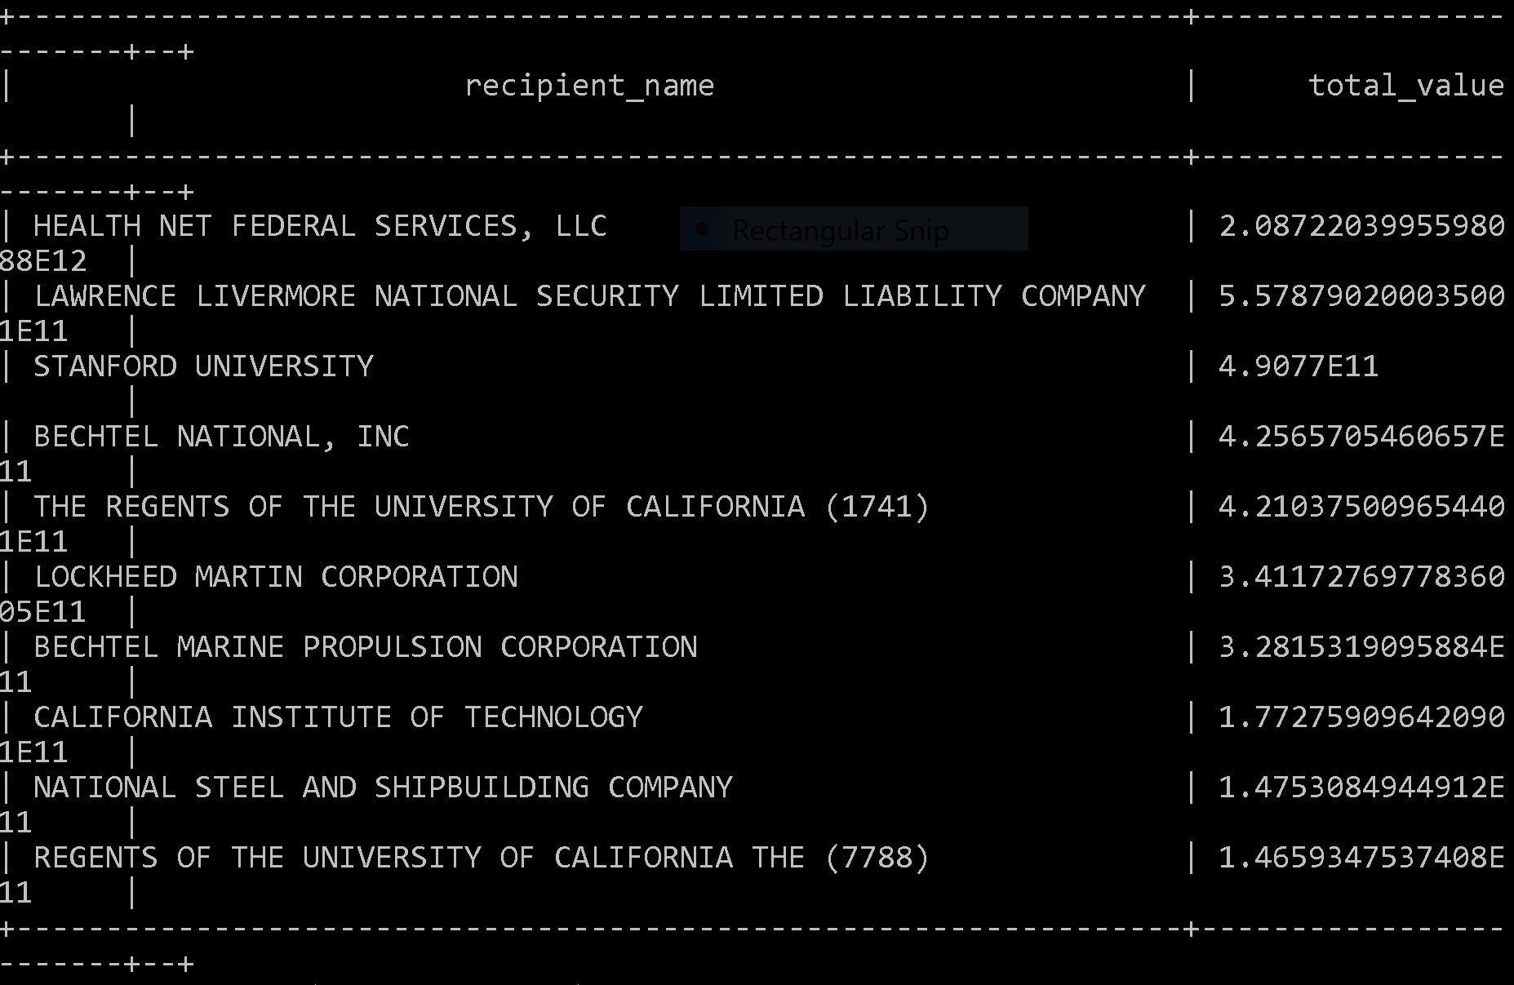
Top Contract Recipients in California

Slide 22
Top Contract Recipients
--top 100 largest contracts awarded INSERT OVERWRITE DIRECTORY '/user/svallej5/_project/results/top_c_recipients/' ROW FORMAT DELIMITED FIELDS TERMINATED BY '\t' STORED AS TEXTFILE SELECT recipient_name, sum(current_total_value_of_award) Total_Contract_Value, awarding_agency_name FROM contracts_prime_trimmed GROUP BY recipient_name, awarding_agency_name ORDER BY Total_Contract_Value DESC LIMIT 100;

Slide 23
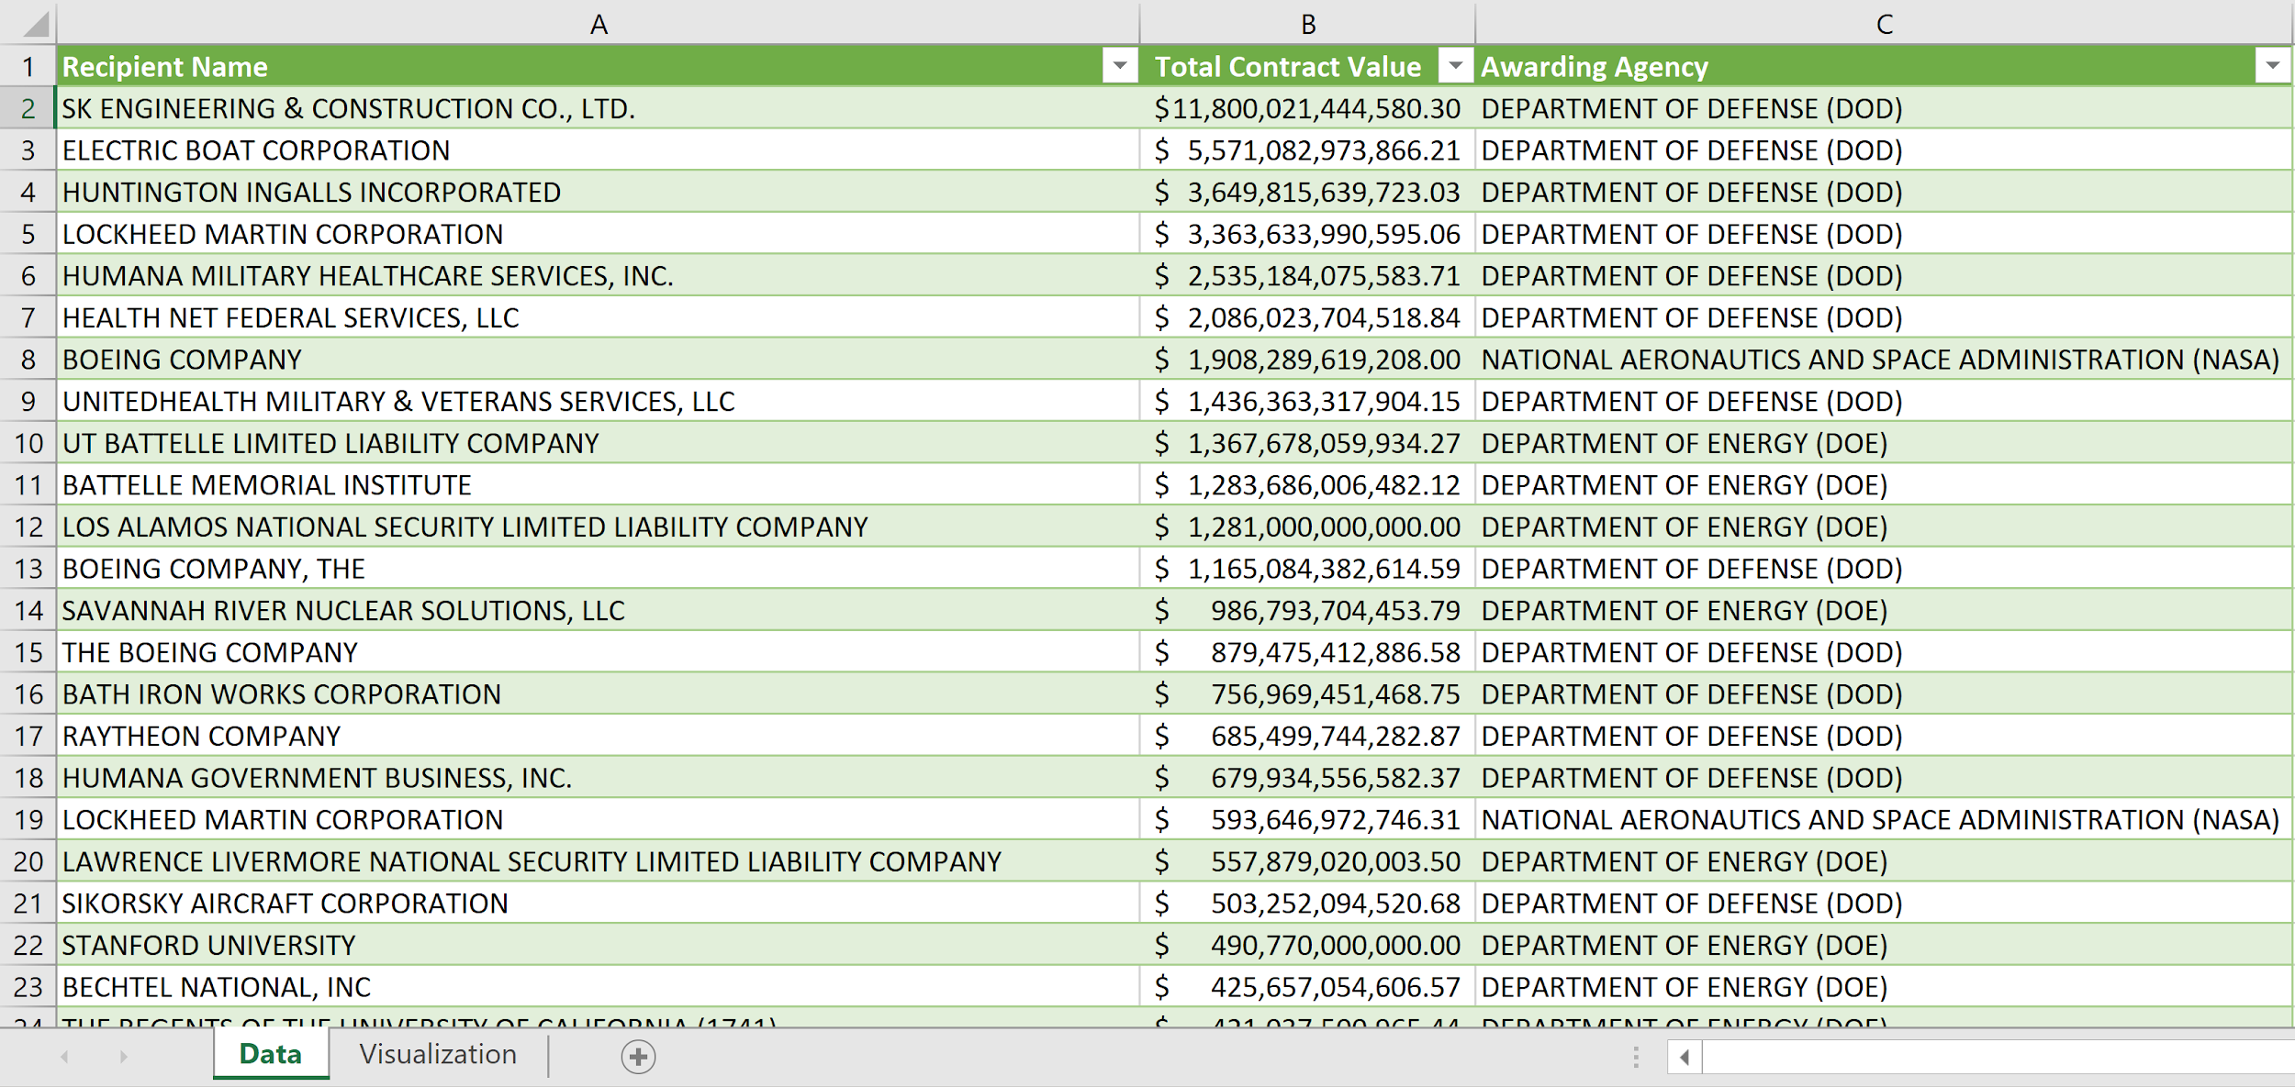
Top Contract Recipients

Slide 24
Top Assistance Recipients
--top 100 assistance recipients INSERT OVERWRITE DIRECTORY '/user/svallej5/_project/results/top_a_recipients/' ROW FORMAT DELIMITED FIELDS TERMINATED BY '\t' STORED AS TEXTFILE SELECT recipient_name, sum(total_funding_amount) Total_Assistance_Value, awarding_agency_name FROM assist_prime_trimmed GROUP BY recipient_name, awarding_agency_name ORDER BY Total_Assistance_Value DESC LIMIT 100;

Slide 25
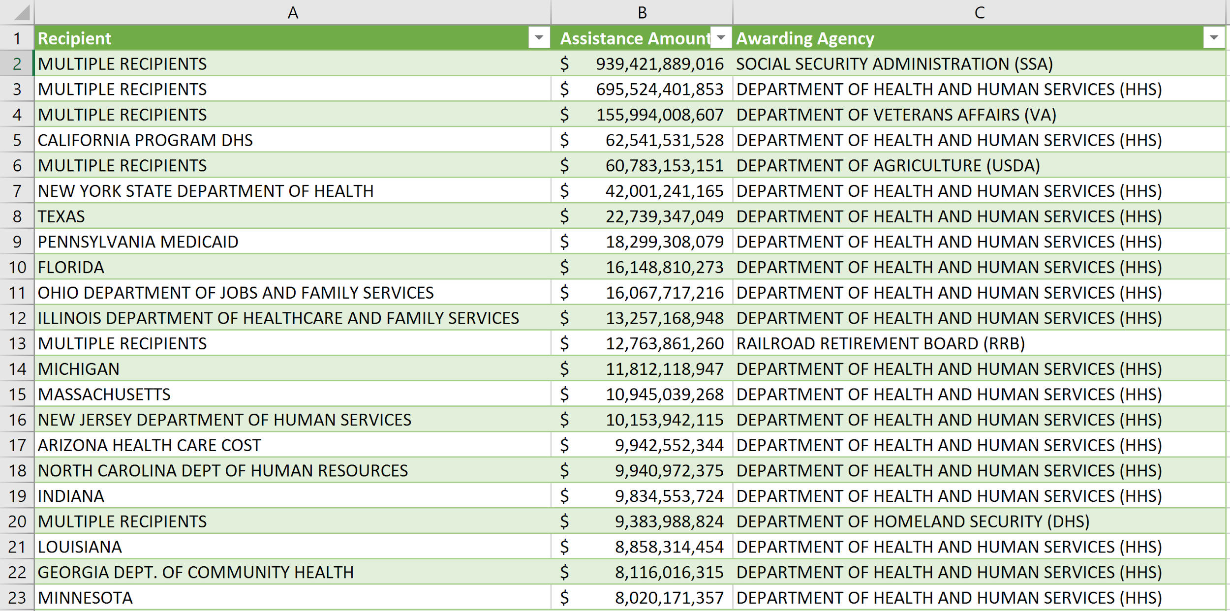
Top Assistance Recipients

Slide 26
Assistance Data
INSERT OVERWRITE DIRECTORY '/user/svallej5/_project/results/assis_trimmed/'
ROW FORMAT DELIMITED
FIELDS TERMINATED BY '\t'
STORED AS TEXTFILE
SELECT
action_date, total_funding_amount,
recipient_name,
recipient_address_line_1,
recipient_city_name, recipient_state_name,
awarding_agency_name,
assistance_type_description, award_description
FROM assist_prime_trimmed;

Slide 27
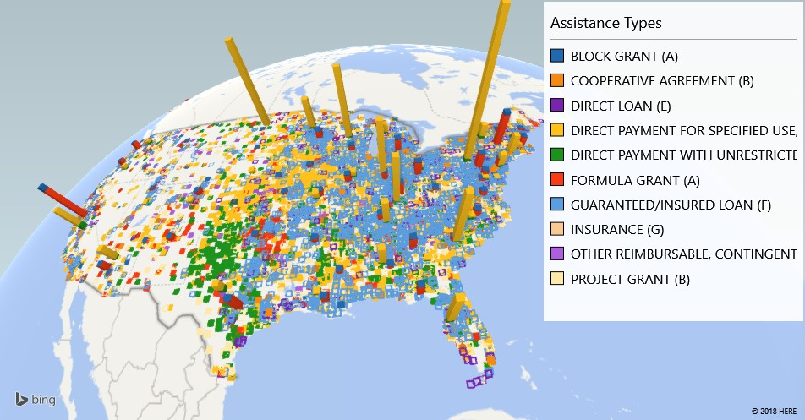

Slide 28
Contracts Data
INSERT OVERWRITE DIRECTORY '/user/svallej5/_project/results/contr_trimmed/'
ROW FORMAT DELIMITED
FIELDS TERMINATED BY '\t'
STORED AS TEXTFILE
SELECT
action_date, current_total_value_of_award,
recipient_name,
recipient_address_line_1,
recipient_city_name, recipient_state_name,
awarding_agency_name,
award_type, award_description
FROM contracts_prime_trimmed;

Slide 29
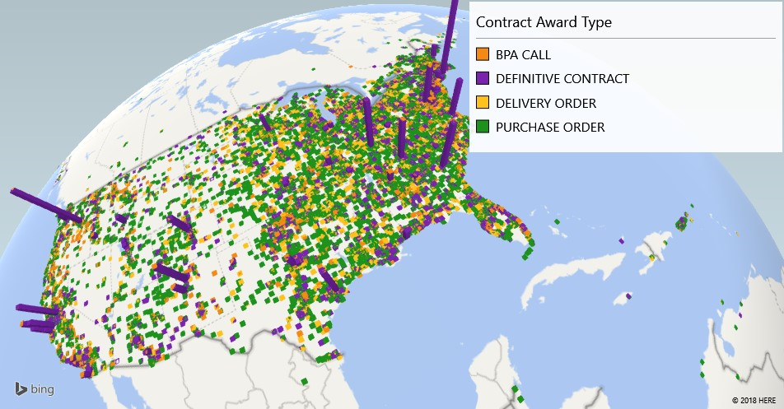
Notes:
A Blanket Purchase Agreement, or BPA, is a simplified method of filling anticipated repetitive needs for supplies or services
A Definitive Contract is a mutually binding legal relationship obligating the seller to furnish the supplies or services (including construction) and the buyer to pay for them.

Slide 30
Documents
Github Repository
US Spending Data

Slide 31
